Slide 1

Number of Airline Passengers Analysis
Will Drogosch, Jaden Healy, Mikee Barker, Ben James

Slide 2

Introduction
U.S. Domestic Airline Passenger Volumes
Objective
Conduct a time-series analysis (2002–2013) to investigate what features affect U.S. domestic airline passenger demand.
Hypothesis
Spikes in jet fuel prices, high RPI, and growth in the price of XAL should signal a greater demand for airline travel.
Relevance
Understanding these dynamics is critical for airlines and policymakers in a fluctuating economic landscape.

Slide 3

Data Overview
Primary Variables:
Producer Price Index by Commodity: Fuels and Related Products and Power: Jet Fuel: Monthly data from 2002 to 2013, sourced from FRED (https://fred.stlouisfed.org/series/WPS057203).
US Domestic Airline Passengers: Monthly passenger volume data from 2002 to 2013, sourced from BTS (https://www.transtats.bts.gov/Data_Elements.aspx?Data=2).
XAL (Airline Index): Monthly data from 2002 to 2013, sourced from Yahoo Finance (https://finance.yahoo.com/quote/%5EXAL/).
Control Variables:
Real Personal Income (RPI): Monthly data from 2002 to 2013, sourced from FRED (https://fred.stlouisfed.org/series/RPI).
Median Consumer Price Index (CPI): Monthly data from 2002 to 2013, sourced from FRED (https://fred.stlouisfed.org/series/MEDCPIM158SFRBCLE).
Producer Price Index (PPI) for Jet Fuel: Monthly data from 2002 to 2013, sourced from FRED (https://fred.stlouisfed.org/series/WPS057203).

Slide 4
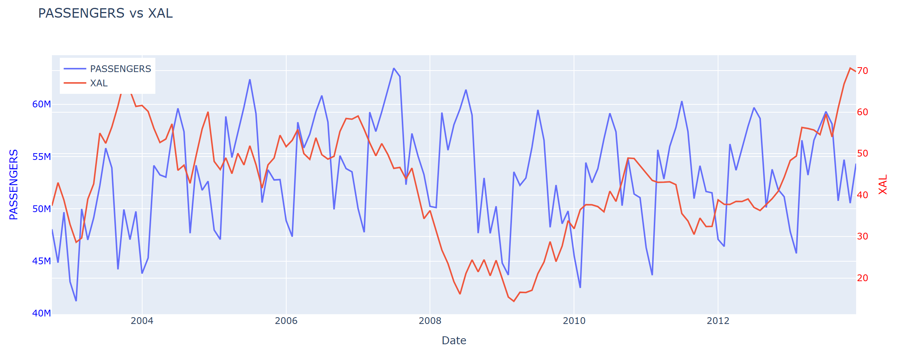
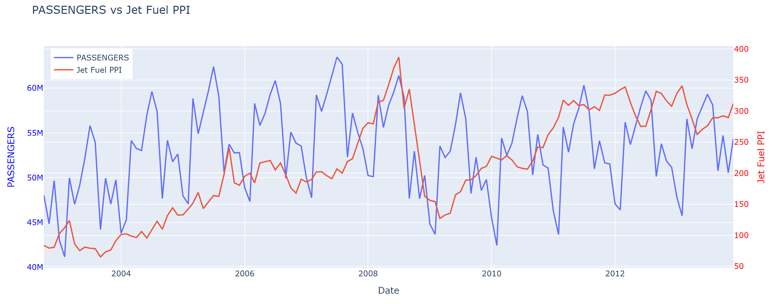

Slide 5
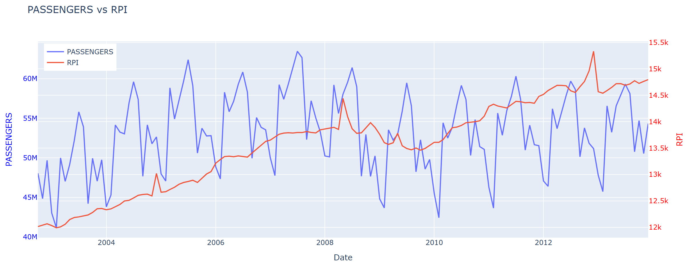
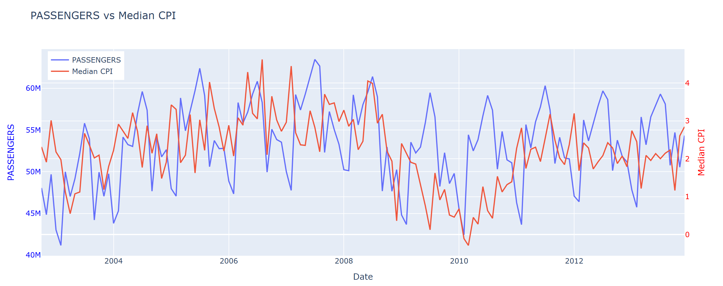

Slide 6
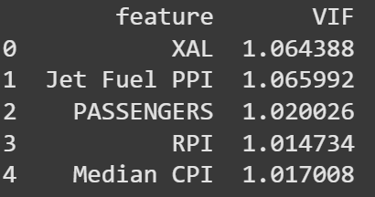
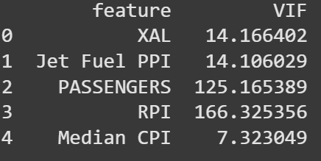
Multicollinearity
After VIF test, we confirmed widespread multicollinearity
A percent change transformation eliminated high correlation

Slide 7
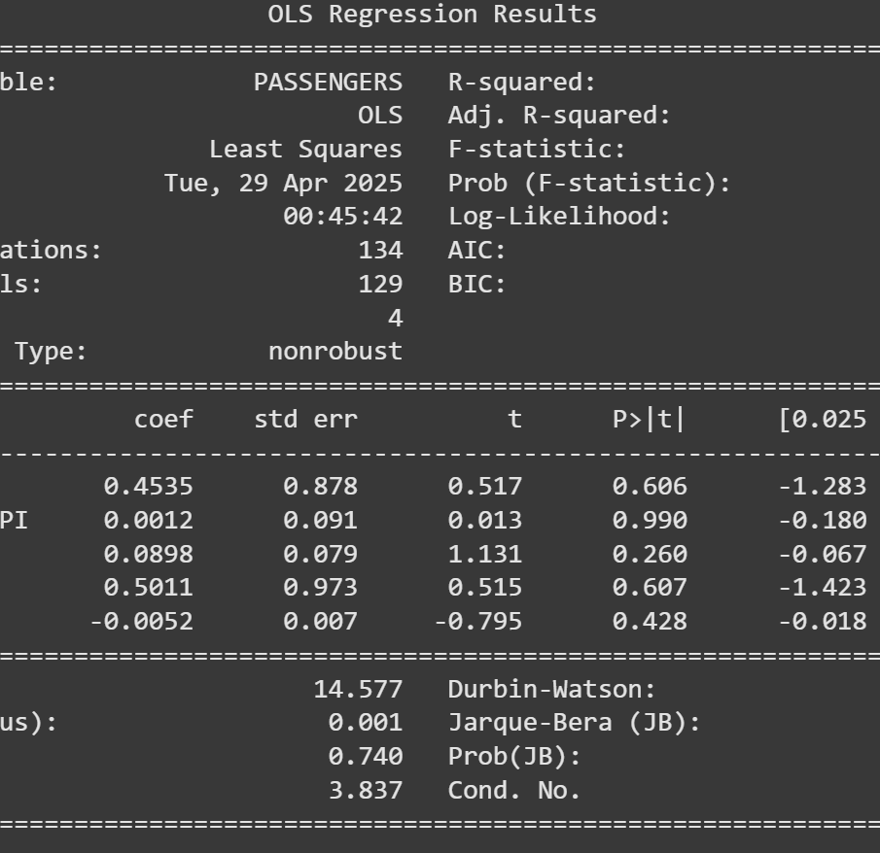
OLS
Initial OLS models yielded poor results
Not a single statically significant relationship

Slide 8
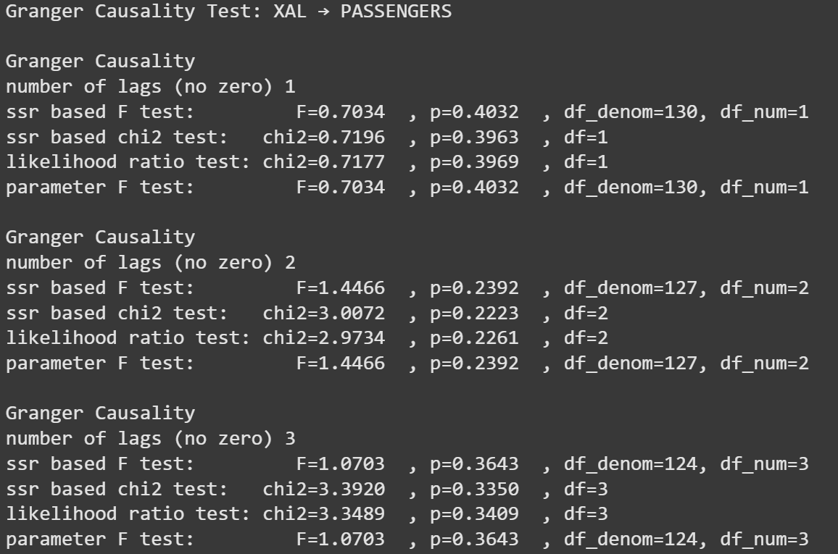
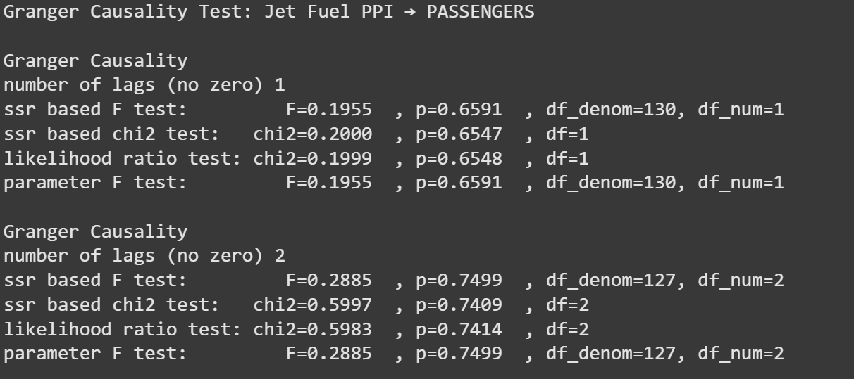
Granger Causality
Confirmed that there is no relationship between the chosen variables and airline travel

Slide 9

PCA
Implemented to potentially improve predictive power by focusing on the directions of greatest variance in the data
Compress information from many related variables into a smaller number of unrelated components
Applied to the original dataset

Slide 10
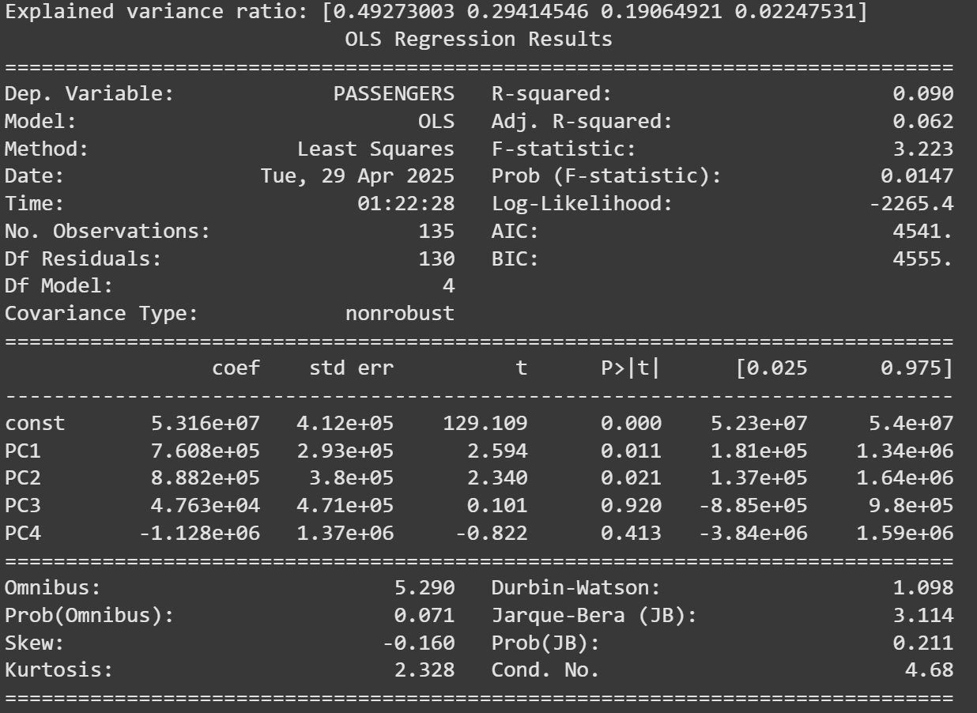
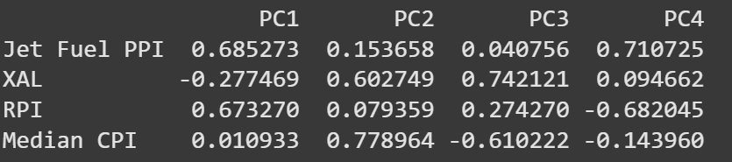
PCA Results
Poor results overall
One statistically significant PC
Jet Fuel PPI and RPI main contributors

Slide 11
Accounting for Seasonality
Created a "Month" variable from the date to capture repeating annual travel patterns (summer booms, winter slowdowns).
Generated month dummy variables (January, February, etc.) so the model could adjust for differences between specific months.
Added a lagged passengers variable (PASSENGERS_LAG1) to capture momentum effects — how last month's travel volume impacts this month.
Significantly improved model accuracy, raising R² above 0.95 by explaining both predictable seasonality and underlying travel inertia.

Slide 12
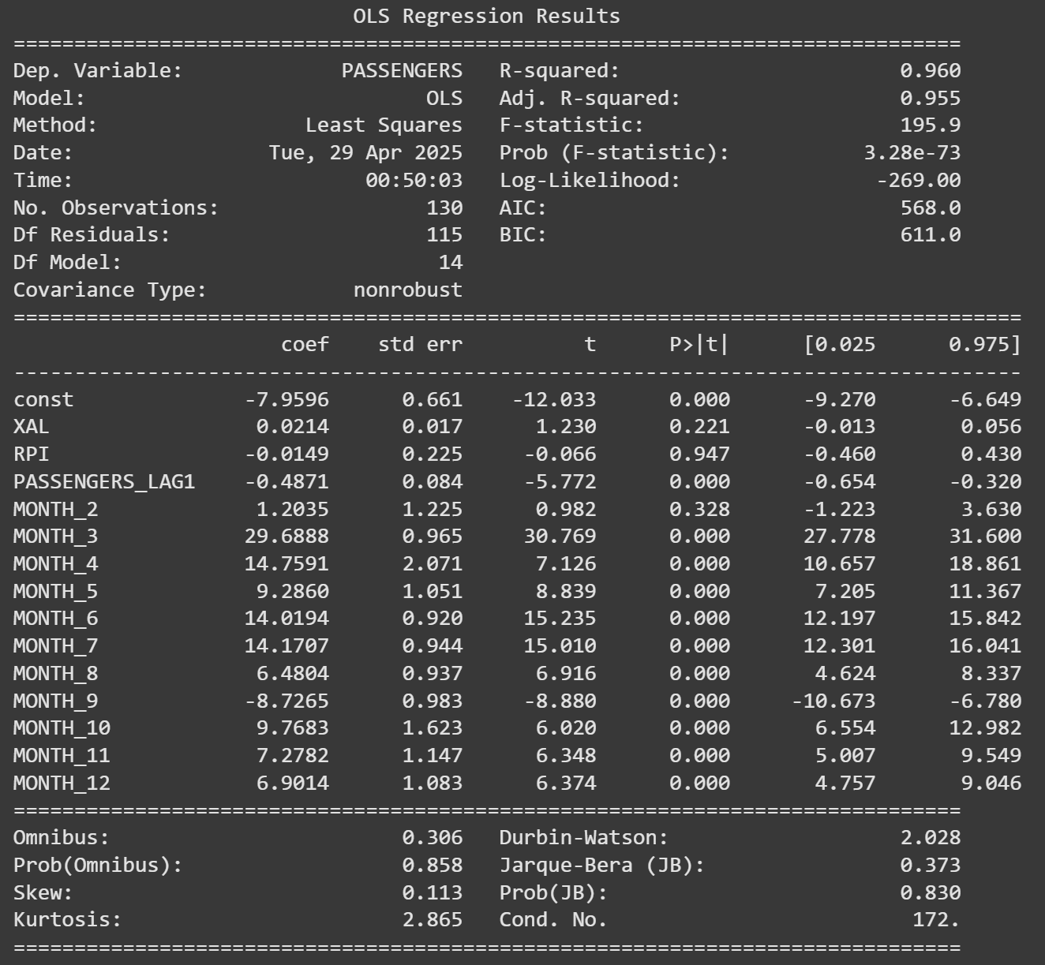
OLS Accounting for Seasonality
Model Performance
Achieved R² = 0.96 and Adjusted R² = 0.955, indicating the model explains 96% of the variance in monthly passenger change.
Durbin-Watson = 2.03, suggesting no autocorrelation in residuals (independent errors).
Key Findings
Seasonality is the dominant driver of passenger volume:
Months like March, April, June, and July show very large positive effects (e.g., March coefficient = +29.69, p < 0.001).
Indicates strong recurring seasonal spikes — e.g., spring break, summer travel.
Momentum matters:
Lagged PASSENGERS (-0.487) is statistically significant (p < 0.001).
Suggests that months with higher traffic are often followed by a correction.
Macroeconomic indicators are not statistically significant:
XAL (Airline stock index) and RPI (Real Personal Income) both show high p-values, meaning they don’t add predictive value after controlling for seasonality and lag.

Slide 13

Implications
Forecasting models for air travel must include seasonal dummies and lag structure to capture behavior patterns.
Market-level or economic predictors like fuel price, income, or airline index add little predictive power when strong seasonal cycles are already captured.
This model can reliably explain short-term monthly passenger changes and forms a strong baseline for potential forecasting or policy simulations.
Airlines respond to this well by offering promotions during low-travel seasons and spiking up prices during periods of high demand.

Slide 14

Questions

